Slide 1
Introduction to Strings Part II Course Title: Programming Language II Course Code: CSE 111 Semester: Summer 2020 Lecture - 8

Slide 2
Last Lecture
Introduction
Indexing
Mutability of String
Basic String operations
Concatenation
Deletion
Repetition
Slicing

Slide 3
Today’s Lecture
Escape sequence
Formatting
Strings
Numbers
ASCII code
String functions

Slide 4
Escape Sequence
Strings are represented using single quotes(ex. 'Hello') or double quotes(ex. "Hello")
What if we a single quote or double quote inside a String?
For example,
Interpreter gets confused.
If you have a substring inside a String that is surrounded by double quotes(""), then use single quotes('') to represent String and vice versa. For example,
s = "I loved the movie "Big Hero 6""
print(s)
Output:
SyntaxError: invalid syntax
Did the String end here?
s = "I loved the movie 'Big Hero 6'" or s = 'I loved the movie "Big Hero 6"'
print(s)
Output:
I loved the movie 'Big Hero 6' or I loved the movie "Big Hero 6"

Slide 5
Escape Sequence
Better solution to the previously mentioned problem is using Escape sequence( \ ).
If you have some special character inside your String that might confuse the interpreter, you can use escape sequence to clarify. For example,
Go to this link to see more Escape sequences.
Another solution to the previously mentioned problem is using triple quotes ('''''').
s = "I loved the movie \"Big Hero 6\""
print(s)
Output:
I loved the movie "Big Hero 6"

Slide 6
Formatting String
Use format() function to format Strings.
format() is a powerful and versatile function.
Basic formatting example:
s = "Hello {}, I am {}.".format("Bob", "Alice")
print(s)
s = "Hello {0}, I am {1}.".format("Bob", "Alice")
print(s)
s = "Hello {1}, I am {0}.".format("Bob", "Alice")
print(s)
s = "Hello {speaker}, I am {ThirdPerson}.".format(speaker="Bob", ThirdPerson ="Alice")
print(s)
0 | 1
Output:
Hello Bob, I am Alice.
Hello Bob, I am Alice.
Hello Alice, I am Bob.
Hello Bob, I am Alice.

Slide 7
Number formatting
format( ) function can also used for formatting numbers.
For example,
More number formats: b, o, x, e, % etc.
s = "Hello {0}, can you lend me {1:d}$?".format("Bob", 100)
print(s)
s = "I am {0}, {1}. I have only {2:4.2f}$.".format("sorry", "Alice",50.95876)
print(s)
s = "Its ok, {}.".format("Bob")
print(s)
Output:
Hello Bob, can you lend me 100$?
I am sorry, Alice. I have only 50.96$.
Its ok, Bob.

Slide 8
Number formatting with alignment
format( ) function can also used for formatting numbers with alignment.
< for left alignment
^ for center alignment
> for right alignment
For example,
print("{:<d}".format(20))
print("{:^14.3f}".format(20.1235))
print("{:>9d}".format(30))
print("{:>09d}".format(30))
print("{0:<d}|{1:^14.3f}|{2:>9d}".format(20,20.1235,30))
Output:
20
20.123
30
000000030
20| 20.123 | 30
Follow this link to know more about formatting.

Slide 9
ASCII
Machines do not understand characters or decimals.
Only binary numbers (0s and 1s)
Every character is converted to an integer number called the “ASCII code”.
The ASCII code is converted to binary numbers.
ASCII (American Standard Code for Information Interchange) is a code for representing any character typed using keyboards as numbers, assigned from 0 to 127.
You can convert a character to its corresponding ASCII value using ord(character) function and convert number to its corresponding character using chr(int) function.
For example,
Instructions | Output
ord('a') | 97
ord('A') | 65
ord('Z') | 90
chr(97) | 'a'
chr(65) | 'A'

Slide 10
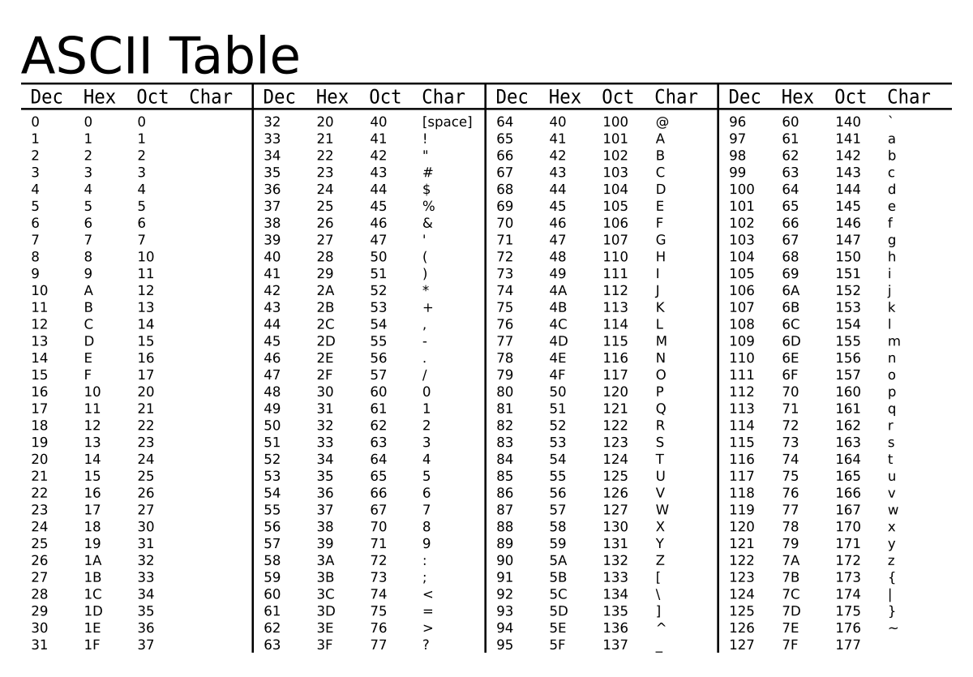
ASCII Table
You can see the ASCII table to find the ASCII value of the corresponding characters.

Slide 11
String Functions
lower() returns a copy of the string with all lower case letters.
upper() returns a copy of the string with all upper case letters.
strip() returns a copy of the string with all whitespace removed before and after the string.
count(substring) returns total occurrence of substring in the main string.
startswith(substring) returns True if the string starts with given substring; Otherwise returns False.
endswith(substring) returns True if the string starts with given substring; Otherwise returns False.
find(substring) returns the index of first occurrence of substring in the main string.
replace(oldstring, newstring) replaces every instance of the oldstring with newstring.

Slide 12
String Functions(Example)
Instructions | Output
s = 'Hello World'
tmp = s.lower()
print(s) | Hello World
print(tmp) | hello world
' Hello World '.strip() | 'Hello World'
' Hello World '.rstrip() | ' Hello World'
' Hello World '.lstrip() | 'Hello World '
'Hello World'.count('l') | 3
'Hello World'.find('l') | 2
'Hello World'.replace('l', 'x') | 'Hexxo Worxd'
'Hello World'.startswith('He') | True

Slide 13
String Functions
Use dir(String) to see all the methods in String class.
Run this instruction: dir('Hello')
Follow this link to know about all the functions.
Output:
['__add__', '__class__', '__contains__', '__delattr__', '__dir__', '__doc__', '__eq__', '__format__', '__ge__', '__getattribute__', '__getitem__', '__getnewargs__', '__gt__', '__hash__', '__init__', '__init_subclass__', '__iter__', '__le__', '__len__', '__lt__', '__mod__', '__mul__', '__ne__', '__new__', '__reduce__', '__reduce_ex__', '__repr__', '__rmod__', '__rmul__', '__setattr__', '__sizeof__', '__str__', '__subclasshook__', 'capitalize', 'casefold', 'center', 'count', 'encode', 'endswith', 'expandtabs', 'find', 'format', 'format_map', 'index', 'isalnum', 'isalpha', 'isascii', 'isdecimal', 'isdigit', 'isidentifier', 'islower', 'isnumeric', 'isprintable', 'isspace', 'istitle', 'isupper', 'join', 'ljust', 'lower', 'lstrip', 'maketrans', 'partition', 'replace', 'rfind', 'rindex', 'rjust', 'rpartition', 'rsplit', 'rstrip', 'split', 'splitlines', 'startswith', 'strip', 'swapcase', 'title', 'translate', 'upper', 'zfill’]

Slide 14
Summary
If we have a substring inside a String that is surrounded by double quotes(""), we can use Escape sequence to treat the quotes as part of our String.
Strings and numbers can be formatted using format() function.
Every character can be represented using ASCII code.
String class a lot of methods to make our work easy. We can see them using dir() function.

Slide 15
Next Lecture
Introduction to Lists
List Manipulation
Creation
Indexing
Adding, accessing and removing elements
Mutability
Slicing
Concatenation

Slide 16


